Slide 1
Employee data Analysing using Excel
Studenege name: s. Aarthi
Register No: 312208437
Department: b.com general
College: chellammal womanS collge

Slide 2
Employee performance analysing using Excel

Slide 3
Agenda
1.problem statement
2.project overview
3.end users
4.our solution anda proposition
5.dataset description
6.modeling approch
7.results and discussion
8.conclusion

Slide 4
Problem statement
This presentation aims to analyse existing employees performance data to uncover actionable insights, develop targeted strategies for performance enhancement and support data driven motivated workforce

Slide 5
Project overview
The employee performance data analysis project evaluates metrics like productivity, quality of work, and attendance to identify Trends and areas for improvement. By analysing this data, the project aims to uncover strengths and weakness, offering actionable insights and recommendations to enhance overall performance and align with organization goals

Slide 6
Who are the end users?
- hr managers
- team leaders
- department heads
- senior executives
- performance analysts
- training and development teams
- employee relations specialists
- data analysts etc.

Slide 7
OUR SOLUTION AND ITS VALUE PROPOSITION➢ Filtering: Enhanced data accuracy by isolating relevant subsets, which improved focus on specific performance metrics and streamlined analysis.➢ Slicer: Enabled interactive data exploration by providing dynamic filtering options, allowing users to easily segment and analyze data across different dimensions.➢ Pivot Table: Summarized large datasets effectively by aggregating and reorganizing data, facilitating in-depth analysis and insight into key performance indicators.➢ Graph: Visualized data trends and patterns through charts, making complex information more accessible and actionable for stakeholders.

Slide 8
DATASET DESCRIPTION Employee dataset-Naan Mudhalvan Dashboard Total Features-26 Features Used-9 Employee ID-Number Name-Text Gender-Male and Female Employee type-Full time, part time, contract Employee status-Active Employee Rating-Number Business Unit-department

Slide 9
MODELLING - Data Sources and Cleaning Data was extracted from the NM dashboard for comprehensive analysis. Cleaned data to remove inconsistencies and duplicates. Ensured accuracy and completeness for reliable analysis. - Key Metrics and Dimensions Defined dimensions like departments and job roles for detailed analysis. Ensured metrics align with organizational performance goals. -Pivot Table Structure Created pivot tables to summarize and analyze large data sets. Organized data by dimensions like time periods and employee groups. Enabled dynamic filtering for in-depth performance insights. - Types of Visualizations Developed charts and graphs to illustrate performance trends. Used bar charts for departmental comparisons and line graphs for trends over time. Applied heat maps to highlight areas of high and low performance.

Slide 10
MODELLING- Insights and Conclusions : Analyzed visualizations to identify performance patterns and anomalies. Delved into trends to uncover factors influencing employee performance.- Provided actionable recommendations for improving productivity and engagement. Data Integration and Transformation : Applied transformation techniques to standardize and normalize data formats. Ensured consistency and accuracy across integrated data points. Reporting and Presentation : Designed visual aids to effectively communicate insights and recommendations. Presented key findings and actionable steps for strategic decision-making.

Slide 11
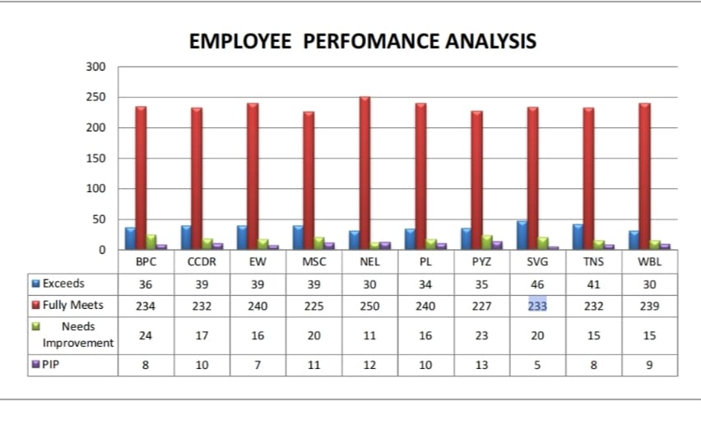
Result

Slide 12
CONCLUSION PIP<15 IN EACH DEPARTMENT NEEDS IMPROVEMENT <25 IN EACH DEPARTMENTWITH THE PERFORMANCE BEING SHOWN THAT MORE THAN OR EQUAL TO 100 EMPLOYEES IN BOTH MALE AND FEMALE(EACH DEPARTMENT ) HAVE FULLY MET THE PERFORMANCE EXPECTATION AND LESS THAN OR EQUAL TO 20 EMPLOYEES IN EACH DEPARTMENT BEING EXCEEDING THE EXPECTAION THE REST ARE TAKEN AS ''PIP'' AND ''NEEDS IMPROVEMENT''.THESE NUMBER OF EMPLOYEES MIGHT NEED EXTRA MOTIVATION / TRAINING / PRACTICE ON EFFICIENT PERFORMANCE .

